Slide 1

Unit 4

Slide 2
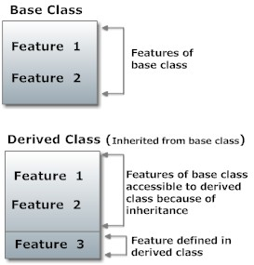
Inheritance
Inheritance is one of the key feature of object-oriented programming including C++ which allows user to create a new class(derived class) from a existing class(base class).
The derived class inherits all feature from a base class and it can have additional features of its own.

Slide 3
Syntax :
  class derived-class: access-specifier base-class
A derived class inherits all base class methods with the following exceptions:
  Constructors, destructors and copy constructors of the base class.
  Overloaded operators of the base class.
  The friend functions of the base class.

Slide 4
Access specifiers
Public Inheritance: When deriving a class from a public base class,
  public members of the base class become public members of the derived class and
  protected members of the base class become protected members of the derived class.
A base class's private members are never accessible directly from a derived class, but can be accessed through calls to the public and protected members of the base class.

Slide 5
Protected Inheritance: When deriving from a protected base class, public and protected members of the base class become protected members of the derived class.
Private Inheritance: When deriving from a private base class, public and protected members of the base class become private members of the derived class.

Slide 6
Types of Inheritance
Single Inheritance
Multiple Inheritance
Hierarchical Inheritance
Multilevel Inheritance
Hybrid Inheritance (also known as virtual inheritance)

Slide 7
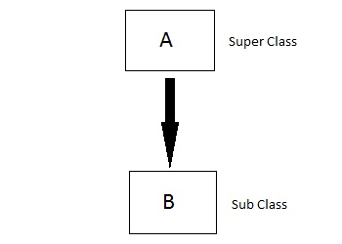
Single inheritance
In this type of inheritance one derived class inherits from only one base class. It is the most simplest form of Inheritance.

Slide 8
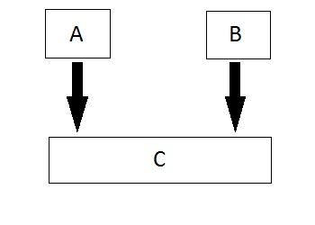
Multiple Inheritance
In this type of inheritance a single derived class may inherit from two or more than two base classes.

Slide 9
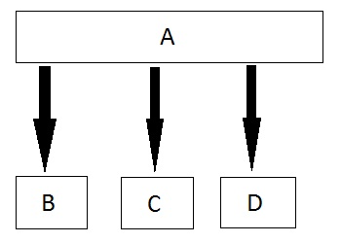
Hierarchical inheritance
In this type of inheritance, multiple derived classes inherits from a single base class.

Slide 10
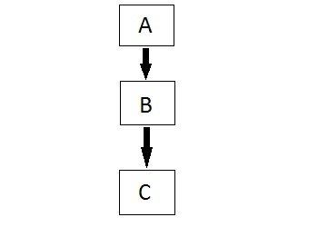
Multilevel Inheritance
In this type of inheritance the derived class inherits from a class, which in turn inherits from some other class. The Super class for one, is sub class for the other.

Slide 11
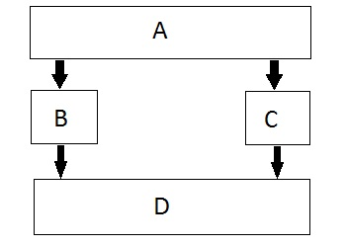
Hybrid (Virtual) Inheritance
Hybrid Inheritance is combination of Hierarchical and Multiple, Mutilevel Inheritance .

Slide 12
Default Constructors in Inheritance
Whenever derived class is created from a base class and base class having a default constructor, then default constructor of base class automatically or implicitly bind with the derived class constructor.

Slide 13
Parameterized constructor in Inheritance
Rules:
Whenever base class having parameterized constructor, base class should also contain default constructor.
Base class parameterized constructor should be invoked inside derived class parameterized constructor.
The base class parameterized constructor should be the first statement in derived class parameterized constructor.
Only one base class constructor is invoked in derived class constructor.

Slide 14
Destructor in Inheritance
The destructors of base class implicitly bind with the destructor of derived class.
Base class destructor is the last statement of derived class destructor. Therefore, first derived class destructor is executed and then base class destructor gets executed.

Slide 15
Virtual base class
When two or more objects are derived from a common base class, you can prevent multiple copies of the base class from being present in an object derived from those objects by declaring the base class as virtual when it is inherited.
This can be done by preceding the base class_name with the keyword virtual when it is inherited.

Slide 16
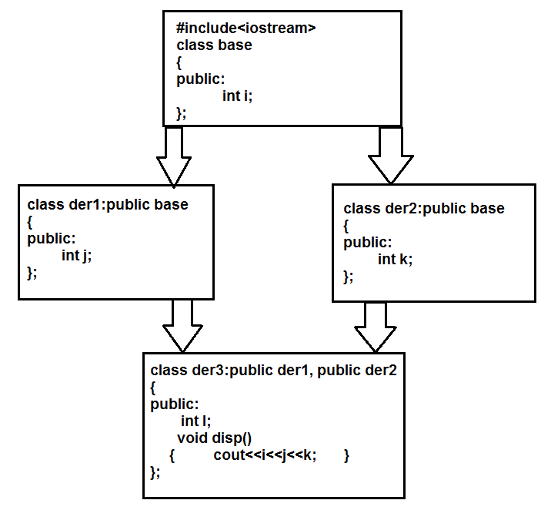


Slide 17
From the prev slide example, the ambiguity would arise in the disp() function, when it has to display the value of ‘i’, since there are two i’s in the der3 class.
This is the problem associated with inheritance.
To overcome this problem we use the concept of ‘virtual base classes’.
The program can be modified to avoid ambiguity as shown in the following program.

Slide 18
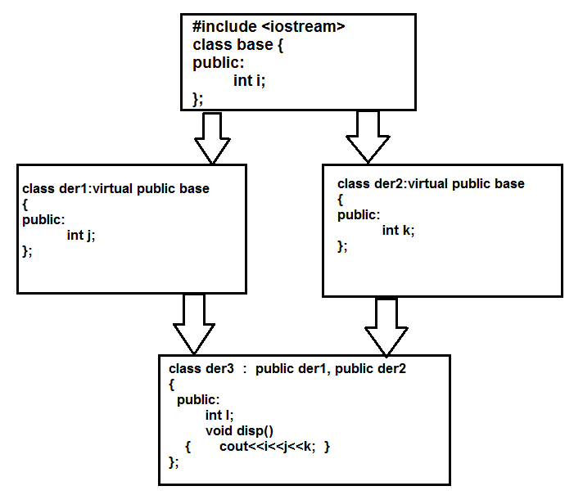

Slide 19
As the base class has been made as virtual during inheritance, only a single copy of ‘i’ would be present in the der3 class. Hence ambiguity is avoided.

Slide 20
VIRTUAL FUNCTIONS
A virtual function is one of the most important OO feature.
Virtual function promotes dynamic polymorphism (runtime polymorphism).
A virtual function is a member function that is declared within a base class and redefined by a derived class.

Slide 21
To create a virtual function, precede the function's declaration in the base class with the keyword virtual.
For ex: We must create 3 classes, square, triangle & circle. Each of which contain display() which would display corresponding shape.
We must create a base class called shape, which act as common base class and also contain display() .
The display() of base class must be made virtual so that it supports polymorphism.
The base class pointer ‘p’ must be created. Using this pointer, display() of derived class must be invoked

Slide 22
Pure Virtual Functions
A pure virtual function is a virtual function that has no definition within the base class.
To declare a pure virtual function, use this general form:
  virtual type func-name(parameter-list) = 0;
When a virtual function is made pure, any derived class must provide its own definition.
If the derived class fails to override the pure virtual function, a compile-time error will result

Slide 23
Pure specifier
The "= 0" portion of a pure virtual function is also known as the pure specifier, because it’s what makes a pure virtual function “pure”.
Although the pure specifier appended to the end of the virtual function definition may look like the function is being assigned a value of 0, that is not true.
The notation "= 0" is just there to indicate that the virtual function is a pure virtual function, and that the function has no body or definition

Slide 24
Abstract classes
Abstract Class is a class which contains atleast one Pure Virtual function in it.
Classes inheriting an Abstract Class must provide definition to the pure virtual function, otherwise they will also become abstract class.

Slide 25
Characteristics of Abstract Class
Abstract class cannot be instantiated, but pointers and references of Abstract class type can be created.
Abstract class can have normal functions and variables along with a pure virtual function.
Abstract classes are mainly used for Upcasting, so that its derived classes can use its interface.
Classes inheriting an Abstract Class must implement all pure virtual functions, or else they will become Abstract too.

Slide 26
Late Binding
To accomplish late binding, Compiler creates VTABLEs, for each class with virtual function. The address of virtual functions is inserted into these tables.
Whenever an object of such class is created the compiler secretly inserts a pointer called vpointer, pointing to VTABLE for that object.
Hence when function is called, compiler is able to resolve the call by binding the correct function using the vpointer.

Slide 27
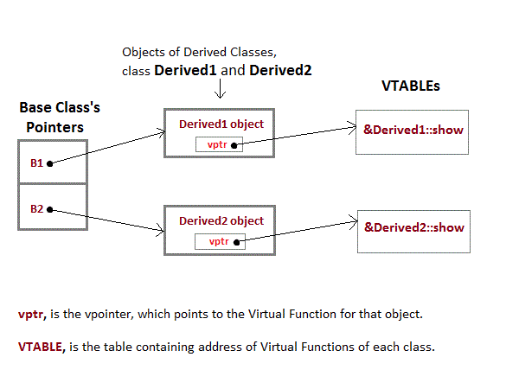

Slide 28
Why can't we create Object of Abstract Class ?
When we create a pure virtual function in Abstract class, we reserve a slot for a function in the VTABLE(studied in last topic), but doesn't put any address in that slot. Hence the VTABLE will be incomplete.
As the VTABLE for Abstract class is incomplete, hence the compiler will not let the creation of object for such class and will display an errror message whenever you try to do so.

Slide 29
END OF UNIT 4

